Slide 1
LEVERAGING BIG DATA: CRIMINAL JUSTICE
CPS_Analytics
Team members: Yuanying Li, Chen Liang, Fangjung Lin, Na Qian
Team Leader : Ketaki Joshi

Slide 2
AGENDA
Part I : How big data is evolved in the industry, benefits of leveraging big data, issues associated, and future.
Part II : Crime numbers comparison and analysis of five cities: Cupertino, Mountain View, Santa Clara, San Jose, and Sunnyvale.
Part III : Necessary Precautions

Slide 3



EVOLUTION
Use of traditional methods
During 1920s
Start of revolution
IACP formed a committee
Foundation of Uniform Crime reporting program (UCR)
A reliable source for law enforcement administration, operation, and management
Widely used by researchers, politicians, and criminal justice professionals
Since 1960s, with the rise of computer and technology
Use of fingerprints was the beginning of the forensic revolution
DNA test, CCTV, phone surveillance, narco test

Slide 4






BENEFITS
Predictive Policing-helps to identify potential crime activity
In precising resources, prevent crime and cast a wider net
Identifying crime trends and retain important evidence
Improving operation efficiency and effectiveness
Budget formation and allocation
Risk Assessment-estimate the probability of reoffend
Example: In 2016, The local police in Manchester, New Hampshire used advanced analytics and were able to reduce robberies by 12%, burglaries by 21% and thefts from motor vehicles by 32%.

Slide 5
VIOLENT CRIME STATISTICS
An estimated 1,206,836 violent crimes occurred nationwide in 2018. There is a decrease of 3.4% from 2017.
In 2019, from January to June, preliminary figures showed an overall 3.1% decrease compared with the same period in 2018.
# Violent Crime includes murder and nonnegligent manslaughter, rape, robbery, and aggravated assault
Crime in the United States, by Volume per 100,000 Inhabitants
Source: Federal Bureau of Investigation, Crime in the United States 2018, Table I

Slide 6
ISSUES
Problem of bias
Reliability of techniques and data accuracy
Risk assessment tool

Slide 7
CHANGING THE INDUSTRY
Limitation of UCR
Alternative to UCR
Example: Criminal Records Database (CRD)- build by David Eagleman, Ph.D., a neuroscientist at Stanford University in California, and his team at the Center for Science and Law in Texas.
Use of advance analytics to build precise models
Artificial Intelligence (AI)

Slide 8
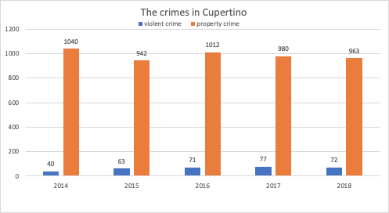
Crimes in Bay Area - Cupertino
2014~2018 Unit: per 100,000
Notes:
In the last 5 years Cupertino has seen an increase in violent crime and a decrease in property crime.
The 2018 crime rate in Cupertino was 2.3 times smaller than the U.S. average. It was higher than 45.3% of U.S. cities. The 2018 Cupertino crime rate is about the same compared to 2017 and lower compared to 2016.

Slide 9
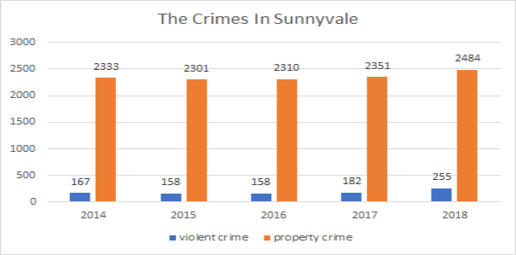
Crimes in Bay Area - Sunnyvale
2014~2018 Unit: per 100,000
Notes:
In the last 5 years Sunnyvale has seen an increase in violent crime and a decrease in property crime.
The 2018 crime rate in Sunnyvale was 2.0 times smaller than the U.S. average. It was higher than 51.7% of U.S. cities. The 2018 Sunnyvale crime rate rose by 8% compared to 2017.

Slide 10
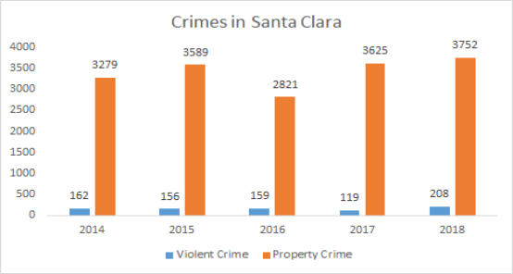
Crimes in Bay Area - Santa Clara
2014~2018 Unit: per 100,000
Notes:
Santa Clara is a vibrant, diverse community with a large population and historically low crime rates which have consistently made it one of the safest large counties in the U.S. This is still the case even as, in 2018, the County experienced an uptick in violent crimes. Some of this is attributable to increases in juvenile crime and some is attributable to increased robberies.

Slide 11
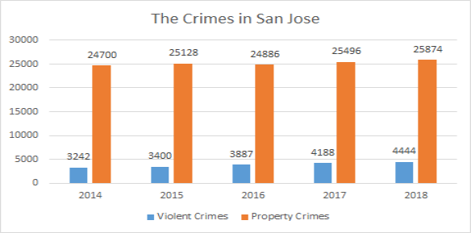
Crimes in Bay Area - San Jose
2014~2018 Unit: per 100,000
Notes:
In the last 5 years San Jose has seen an increase in violent crime and a decrease in property crime.
The 2018 crime rate in San Jose was higher than 80.9% of U.S. cities. The 2018 San Jose crime rate rose by 3% compared to 2017.

Slide 12
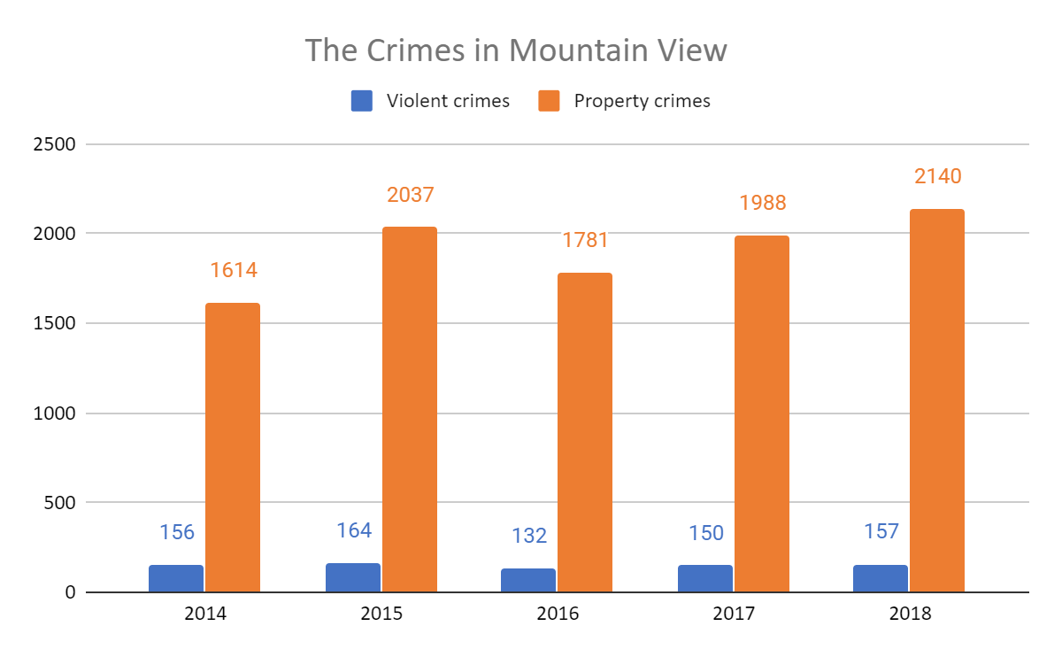
Crimes in Bay Area - Mountain View
2014~2018 Unit: per 100,000
Notes:
Basically, Mountainview is safer than San Jose and Santa Clara. In the last 5 years, Mountain View has seen an increase in property crime. Violent crime rate in mountain view didn’t change too much.
The 2018 crime rate in Mountain View was 1.6 times smaller than the U.S. average. It was higher than in 61.6% of U.S. cities. The 2018 Mountain View crime rate rose by 4% compared to 2017.

Slide 13
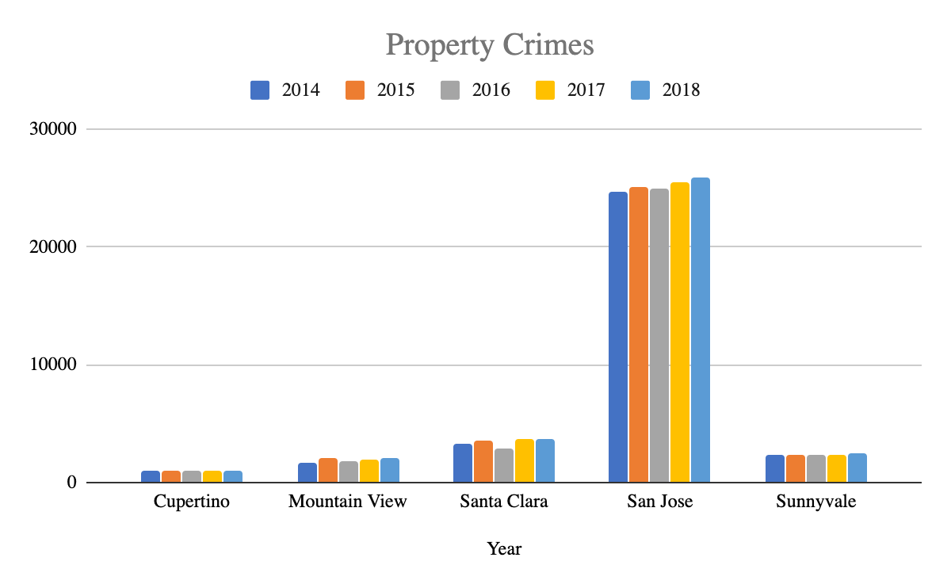
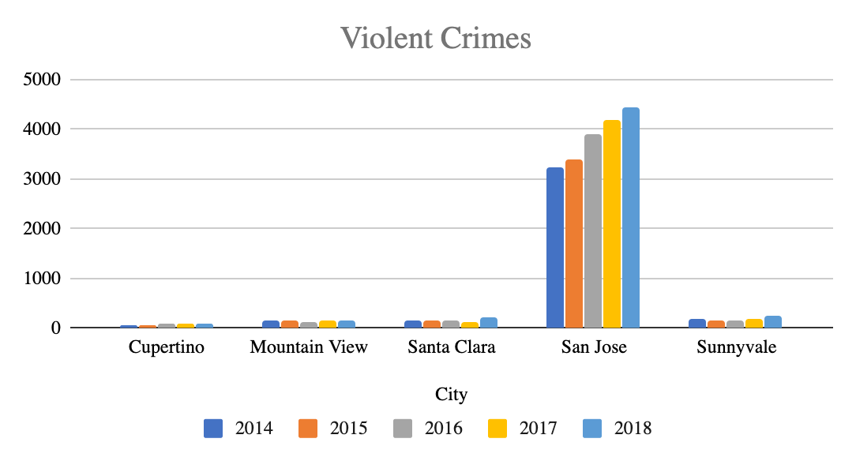
Crimes Comparison among Bay Area
2014~2018 Unit: per 100,000
Notes:
As we can see from the graph, from 2014 to 2018, there are much more crimes in San Jose than any other cities. The crime rate is also increasing in each year. We need to try to avoid being alone on streets and be alert when we are in San Jose. Also, it’s always important not to put personal belongings in cars.

Slide 14
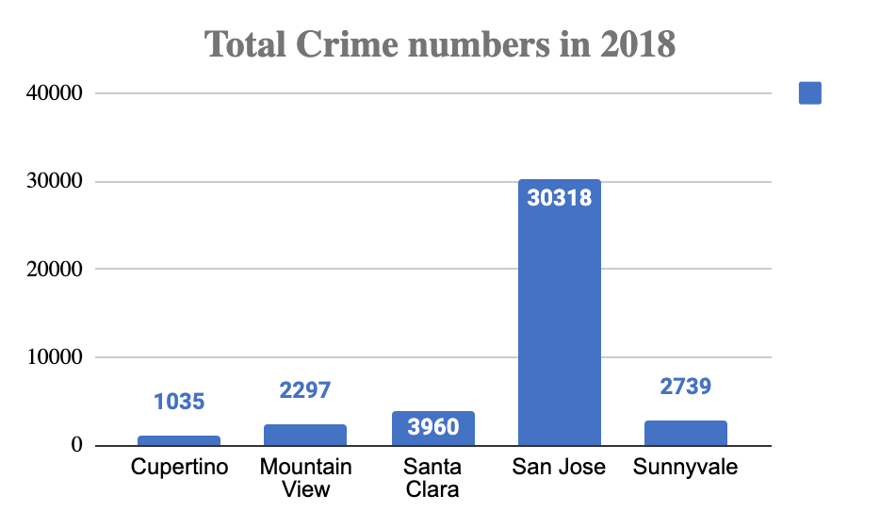
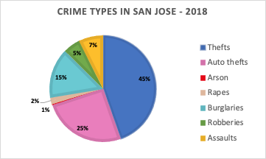
Crimes Comparison among Bay Area in 2018
San Jose is the most serious Unit: per 100,000
Notes:
Let’s take a deeper look, the total crime numbers in San Jose in 2018 is nearly ten times higher than other cities. Among them, thefts accounted for almost half of the total. The second one is auto thefts. Hence, we need to take care of our personal belongings all the time in order not to be the victim in crime.

Slide 15

As an international student, what precautions are necessary?
1.On the street - be alert
2. Out at night-walk on well-lit, busy streets
3.Buses & Train-sit at the front of the bus near the drive
4.Scams & Fraud - Virtual Kidnapping Scam/Purchases/Tutors/Unknown Phone calls

Slide 16
As an international student, what precautions are necessary?
5.Apartment Security - deal directly with landlord and pay your rent with a cheque(never cash)
6.Relationships/Sexual- Assault- No means No
7.Bicycling- don’t ride on the sidewalk or in crosswalk
8.Bank Machines (ATMs)-don’t share your PIN with anyone

Slide 17
Some forecasting will be made during Coronavirus
Coronavirus: Crime concerns as disruption widens and Discrimination isn’t helping contain the Coronavirus
Five rules we should obey to help to STOP spread
STAY at home if you can
HAND Wash them often
ELBOW Cough into it DO THE FIVE!
FACE Don’t touch it
FEET Stay more than 3 feet apart
If ATTACKED
Remain as calm as possible.
PASSIVE RESISTANCE
ACTIVE RESISTANCE

Slide 18


Q & A
THANK YOU
QUESTIONS?

